Slide 1
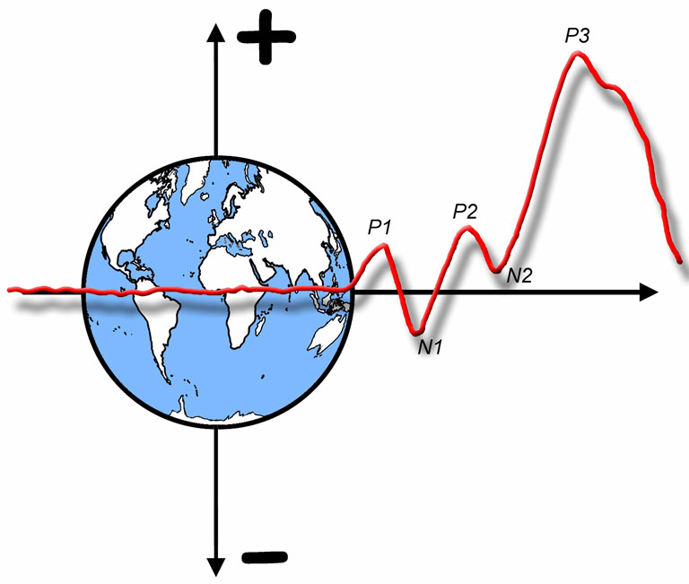

The ERP Boot Camp
ERP Components: Theory

Slide 2
What is an ERP component?
Early definition: Combination of polarity, latency, and scalp distribution
  C1: Polarity varies with upper/lower position
  P3: Latency varies with stimulus evaluation time
  Auditory N1: Distribution varies with pitch
Circular definition: The effect produced by a given experimental manipulation
  “N400 is the difference produced by a semantic mismatch”
My definition: Scalp-recorded neural activity that is generated in a given neuroanatomical module when a specific computational operation is performed
  Not useful as an operational definition
Notes:
© S. J. Luck. All Rights Reserved. May be used for nonprofit educational purposes if this copyright notice is included. Permission must be obtained from the copyright holder(s) for any other use.

Slide 3
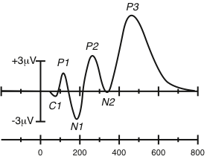
Peaks and Components
An ERP waveform contains several peaks
People typically assume that each peak corresponds to a single underlying “latent” component
Notes:
© S. J. Luck. All Rights Reserved. May be used for nonprofit educational purposes if this copyright notice is included. Permission must be obtained from the copyright holder(s) for any other use.

Slide 4
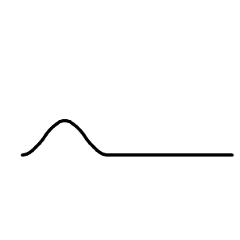
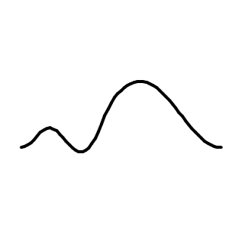
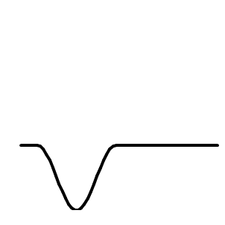
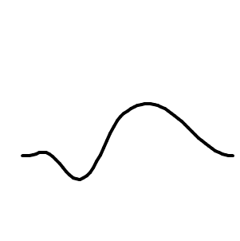
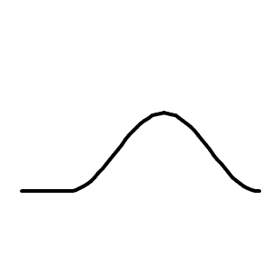

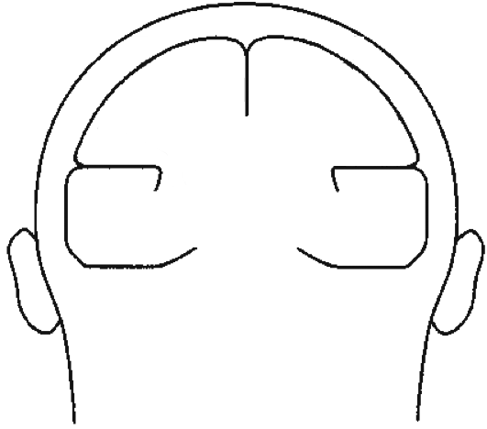
The Superposition Problem
C1
C2
C3
w_{1,1}
E1
w_{2,1}
w_{3,1}
w_{1,2}
w_{2,2}
E2
w_{3,2}
w_{1,3}
w_{2,3}
E3
w_{3,3}
E1
E2
Voltage at an electrode at time t is a weighted sum of all components that are active at time t
There is no foolproof way to recover the underlying components from the observed waveforms
C3
E3
C1
C2
Notes:
© S. J. Luck. All Rights Reserved. May be used for nonprofit educational purposes if this copyright notice is included. Permission must be obtained from the copyright holder(s) for any other use.

Slide 5
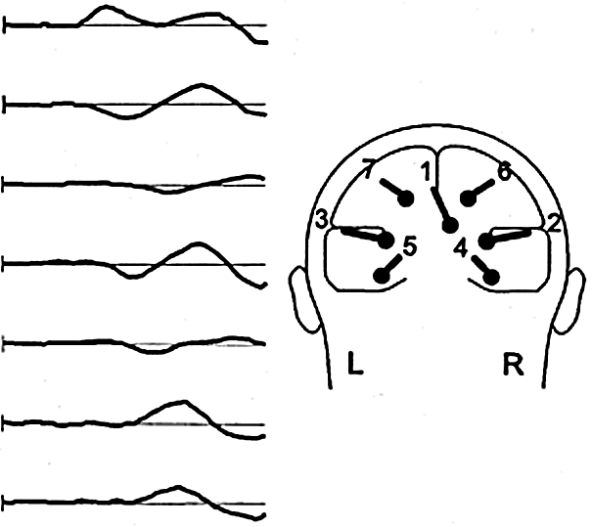
The Superposition Problem
At least 7 components simultaneously active from 50-150 ms for visual stimuli
C1
C2
C3
C4
C5
C6
C7
225 ms
Di Russo et al., 2002
Notes:
Di Russo, F., Martinez, A., Sereno, M. I., Pitzalis, S., &Hillyard, S. A. (2002). Cortical sources of the early components of the visual evoked potential. Human Brain Mapping, 15, 95-111.
Other content: © S. J. Luck. All Rights Reserved. May be used for nonprofit educational purposes if this copyright notice is included. Permission must be obtained from the copyright holder(s) for any other use.

Slide 6
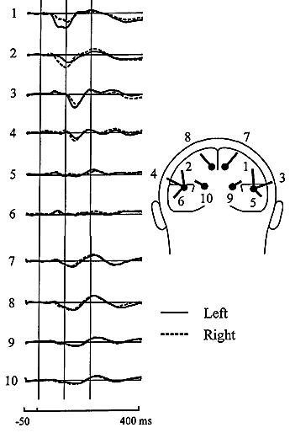
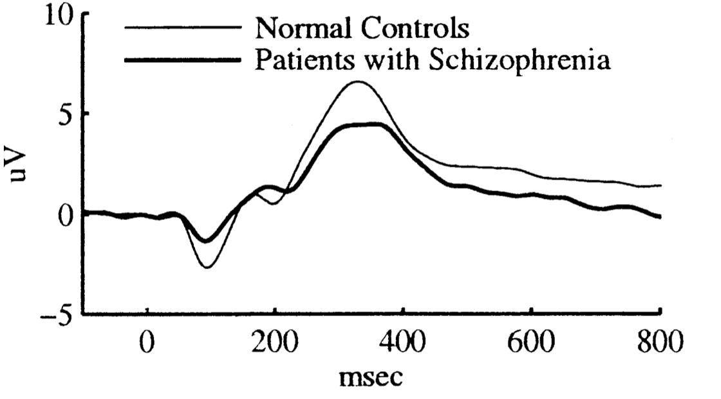
The Superposition Problem
At least 10 components simultaneously active from 50-150 ms for auditory stimuli
How many are active in the P300 period?
Is this really a change in the P300?
Picton et al., 1999
Mathalon et al., 2000
Notes:
Left portion reprinted from Picton, T. W., Alain, C., Woods, D. L., John, M. S., Scherg, M., Valdes-Sosa, P., et al. (1999). Intracerebral sources of human auditory-evoked potentials. Audiology &Neuro-Otology, 4, 64-79, with permission of S. Karger AG, Basel.
Right portion reprinted from Biological Psychiatry, 47(5). Mathalon, D. H., Ford, J.M., Rosenbloom, M., and Pfefferbaum, A. P300 Reduction and Prolongation with Illness Duration in Schizophrenia. 413-427, Copyright (2000), with permission from Elsevier. This material may be used for nonprofit research and education purposes only, and it may not be reprinted or distributed in any form including print and electronic forms.
Other content: © S. J. Luck. All Rights Reserved. May be used for nonprofit educational purposes if this copyright notice is included. Permission must be obtained from the copyright holder(s) for any other use.

Slide 7
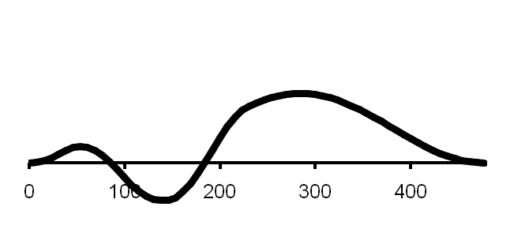
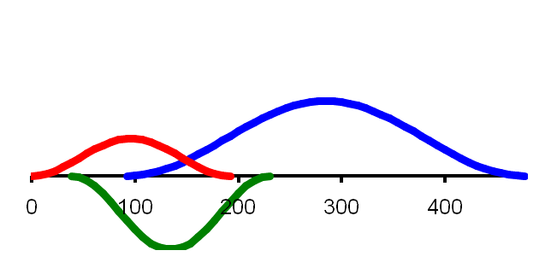
Peaks and Components
Observed Waveform
Peak3
Peak1
Peak2
One possible set of source components
C3
C1
C2
Rule #1- Peaks and components are not the same thing. There is nothing special about the point at which the observed waveform reaches a local maximum.
Notes:
Adapted from Figure 2.1 in Luck, Steven J. (2005). An introduction to the Event-Related Potential Technique. Cambridge, MA: MIT Press.© MIT Press. This material may be used for nonprofit research and education purposes only, and it may not be reprinted or distributed in any form including print and electronic forms.
Other content: © S. J. Luck. All Rights Reserved. May be used for nonprofit educational purposes if this copyright notice is included. Permission must be obtained from the copyright holder(s) for any other use.

Slide 8
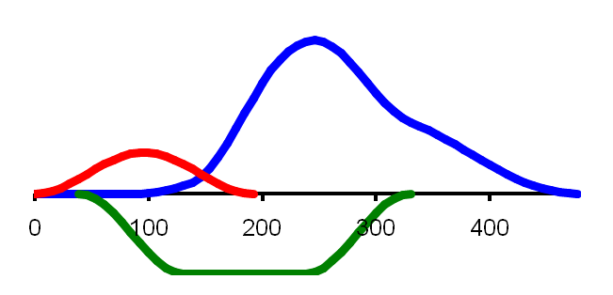
Peaks and Components
Observed Waveform
Peak3
Peak1
Peak2
Rule #2- It is impossible to estimate the time course or peak latency of a latent ERP component by looking at a single ERP waveform—there may be no obvious relationship between the shape of a local part of the waveform and the underlying components.
One possible set of source components
C3
C1
C2
Another possible set of source components
C3’
C1’
C2’
Notes:
Adapted from Figure 2.1 in Luck, Steven J. (2005). An introduction to the Event-Related Potential Technique. Cambridge, MA: MIT Press.© MIT Press. This material may be used for nonprofit research and education purposes only, and it may not be reprinted or distributed in any form including print and electronic forms.
Other content: © S. J. Luck. All Rights Reserved. May be used for nonprofit educational purposes if this copyright notice is included. Permission must be obtained from the copyright holder(s) for any other use.

Slide 9
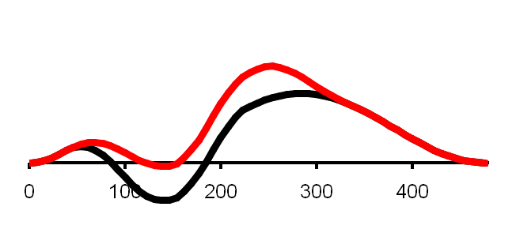
Peaks and Components
Peak3
Peak3
Decrease in C2’ Amplitude
Observed Waveform
Peak1
Peak1
Peak2
Peak2
One possible set of source components
Rule #3- An effect during the time period of a particular peak may not reflect a modulation of the underlying component
C3
C1
C2
Another possible set of source components
C3’
C1’
C2’
Notes:
Adapted from Figure 2.1 in Luck, Steven J. (2005). An introduction to the Event-Related Potential Technique. Cambridge, MA: MIT Press.© MIT Press. This material may be used for nonprofit research and education purposes only, and it may not be reprinted or distributed in any form including print and electronic forms.
Other content: © S. J. Luck. All Rights Reserved. May be used for nonprofit educational purposes if this copyright notice is included. Permission must be obtained from the copyright holder(s) for any other use.

Slide 10
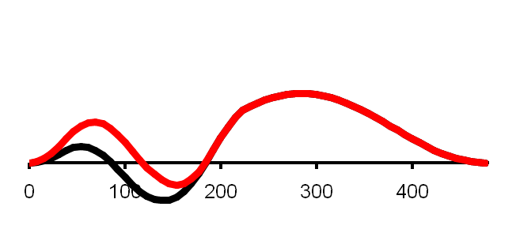
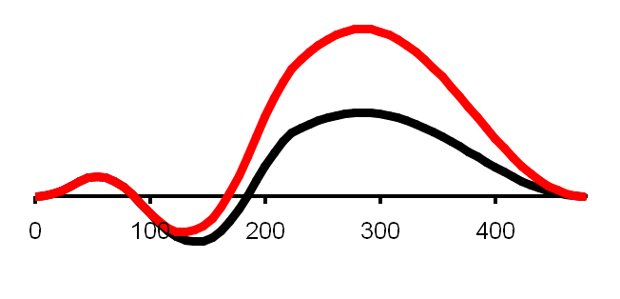
Peaks and Components
Peak3
Peak3
Decrease in C2’ Amplitude
Observed Waveform
Peak1
Peak1
Peak2
Peak2
Rule #4- Differences in peak amplitude do not necessarily correspond to differences in component size, and differences in peak latency do not necessarily correspond to changes in component timing.
One possible set of source components
C3
Peak3
Increase in C1 Amplitude
C1
Peak1
Peak2
C2
Peak3
Another possible set of source components
C3’
Increase in C3 Amplitude
C1’
Peak1
Peak2
C2’
Notes:
Adapted from Figure 2.1 in Luck, Steven J. (2005). An introduction to the Event-Related Potential Technique. Cambridge, MA: MIT Press.© MIT Press. This material may be used for nonprofit research and education purposes only, and it may not be reprinted or distributed in any form including print and electronic forms.
Other content: © S. J. Luck. All Rights Reserved. May be used for nonprofit educational purposes if this copyright notice is included. Permission must be obtained from the copyright holder(s) for any other use.

Slide 11
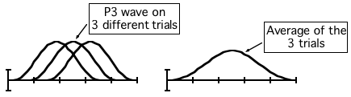
Peaks and Components
Rule #5- Never assume that an averaged ERP waveform accurately represents the individual waveforms that were averaged together. In particular, the onset and offset times in the averaged waveform will represent the earliest onsets and latest offsets from the individual trials or individual subjects that contribute to the average.
Notes:
Adapted from Figure 2.1 in Luck, Steven J. (2005). An introduction to the Event-Related Potential Technique. Cambridge, MA: MIT Press.© MIT Press. This material may be used for nonprofit research and education purposes only, and it may not be reprinted or distributed in any form including print and electronic forms.
Other content: © S. J. Luck. All Rights Reserved. May be used for nonprofit educational purposes if this copyright notice is included. Permission must be obtained from the copyright holder(s) for any other use.

Slide 12
Another Problem
Not only is it hard to know what component changed when a given peak was observed to change, it’s also hard to know if the same components are being tapped in different experiments
  How do we know that the N400 elicited by a semantically incongruous word is the same as the N400 elicited by a low-frequency word?
  We never know for sure
Some components have distinctive properties that make this easier
  Examples: LRP and N2pc
Notes:
© S. J. Luck. All Rights Reserved. May be used for nonprofit educational purposes if this copyright notice is included. Permission must be obtained from the copyright holder(s) for any other use.

Slide 13
What to do?
Strategy #1- Focus on a specific component
Strategy #2- Use well-studied experimental manipulations
Strategy #3- Focus on large components
Strategy #4- Isolate components with difference waves
Strategy #5- Focus on components that are easily isolated
Strategy #6- Use component-independent experimental designs
Strategy #7- Hijack useful components from other domains
Strategy #8- Use a component to assess the processes that came before it
Notes:
© S. J. Luck. All Rights Reserved. May be used for nonprofit educational purposes if this copyright notice is included. Permission must be obtained from the copyright holder(s) for any other use.

Slide 14
What to do?
A different approach: Use a technique that can recover the underlying latent components from the observed data
  Source localization approaches (BESA)
  Principal component analysis (PCA)
  Independent component analysis (ICA)
My opinion: A good experimental design is always better than mathematical hocus-pocus
Notes:
© S. J. Luck. All Rights Reserved. May be used for nonprofit educational purposes if this copyright notice is included. Permission must be obtained from the copyright holder(s) for any other use.

Slide 15
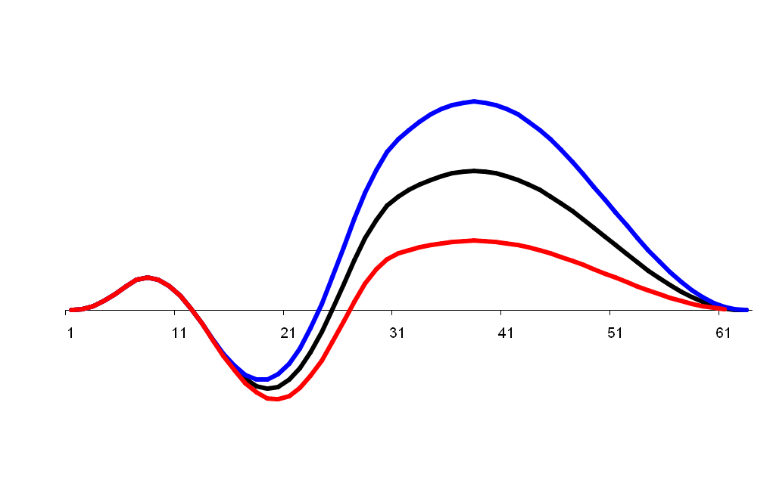
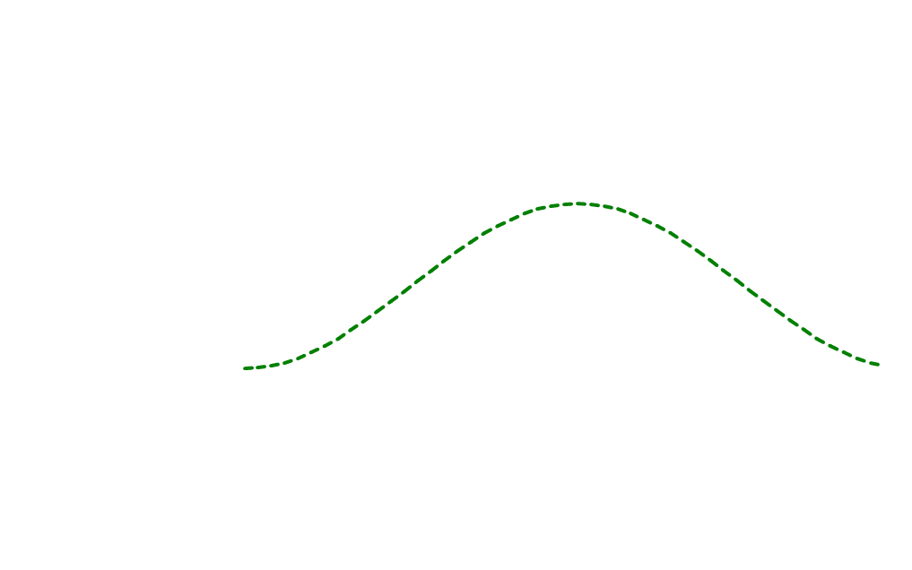
Essence of PCA
A
B
C
Strength of relationship between each time point and underlying factor
3 Conditions or
3 Subjects or
3 Electrode sites
Changes at time B strongly covary with changes at time C but only weakly covary with changes at time A
Hence, B and C are strongly related to a single underlying source of variation, but A is only weakly related
Notes:
© S. J. Luck. All Rights Reserved. May be used for nonprofit educational purposes if this copyright notice is included. Permission must be obtained from the copyright holder(s) for any other use.

Slide 16
Essence of PCA
PCA represents a large number of variables as small number of factors
  Temporal PCA: variables are the time points; factors are component waveforms (e.g., P1, N1, P2, N2, P3 waveforms)
  Spatial PCA: variables are the electrode sites; factors are scalp distributions (e.g., P1, N1, P2, N2, P3 distributions)
A given factor might influence several variables, but to different extents
  An underlying P3 factor might strongly influence voltage at 400 ms and weakly influence voltage at 250 ms
The degree of correlation (or covariance) between two variables will determine the extent to which they “load” on the same factor
Notes:
© S. J. Luck. All Rights Reserved. May be used for nonprofit educational purposes if this copyright notice is included. Permission must be obtained from the copyright holder(s) for any other use.

Slide 17
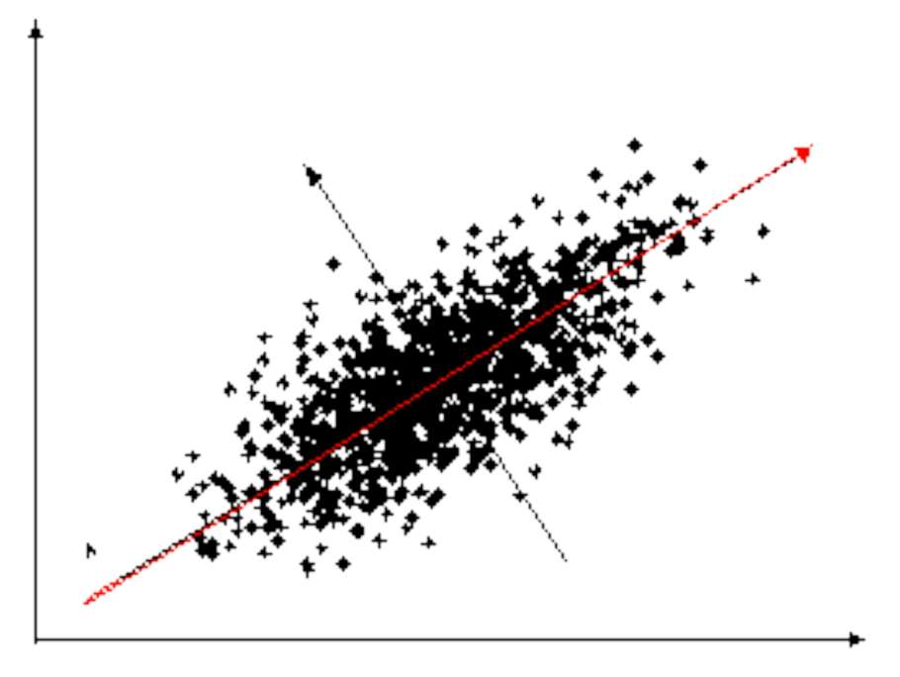
Rotations of factors
New Factor 2:
Noise?
New Factor 1:
Age?
Measured Variable:
Height
Measured Variable:
Weight
Notes:
© S. J. Luck. All Rights Reserved. May be used for nonprofit educational purposes if this copyright notice is included. Permission must be obtained from the copyright holder(s) for any other use.

Slide 18
Basis Functions
Many ERP analysis techniques use a set of “basis functions” which are linearly combined to account for the observed waveforms (or scalp distributions)
  PCA and ICA: Factors
  Localization: Source waveforms
  Fourier analysis: Sine waves
There is an infinite number of sets of basis functions that can be linearly combined to perfectly recreate the observed data
Different techniques vary in the assumptions they make to choose a single set of basis functions
  No existing technique is based on a set of assumptions that are known to be 100% valid
Notes:
© S. J. Luck. All Rights Reserved. May be used for nonprofit educational purposes if this copyright notice is included. Permission must be obtained from the copyright holder(s) for any other use.

Slide 19
PCA Terms
Component ≈ Factor
Eigenvalue
  Measure of amount of variance explained by a given factor
Factor loading
  Extent to which each original variable contributes to a given factor
Factor scores
  Extent to which a given factor is present in a given vector of data values
Rotation
  A set of orthogonal factors can be rotated to become a different set of orthogonal factors
Notes:
© S. J. Luck. All Rights Reserved. May be used for nonprofit educational purposes if this copyright notice is included. Permission must be obtained from the copyright holder(s) for any other use.

Slide 20
Rotations of factors
New Factor 2:
Noise?
New Factor 1:
Age?
Measured Variable:
Height
Measured Variable:
Weight
Notes:
© S. J. Luck. All Rights Reserved. May be used for nonprofit educational purposes if this copyright notice is included. Permission must be obtained from the copyright holder(s) for any other use.

Slide 21
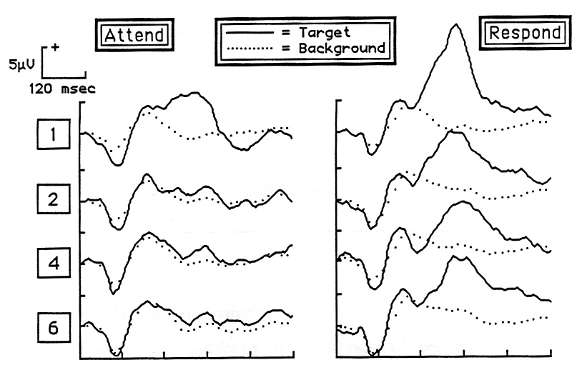
Temporal PCA Example
Target = 880-Hz Tone (p=.10)
Standards = 1, 2, 4, or 6 tones from {220, 275, 330, 440, 550, 660 Hz}
Attend condition: Just attend to the stimuli
Respond condition: Press a button for the target
ERP waveforms from Pz
Luck (1986)
Notes:
© S. J. Luck. All Rights Reserved. May be used for nonprofit educational purposes if this copyright notice is included. Permission must be obtained from the copyright holder(s) for any other use.

Slide 22
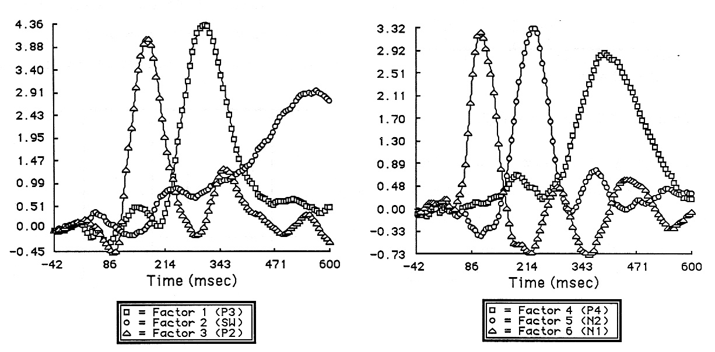
Temporal PCA Example
Factor Loadings
3
1
6
5
4
2
This time point is independently associated with two different sets of other time points
These time points tend to go up and down together across subjects, conditions, and electrode sites
Luck (1986)
Notes:
© S. J. Luck. All Rights Reserved. May be used for nonprofit educational purposes if this copyright notice is included. Permission must be obtained from the copyright holder(s) for any other use.

Slide 23
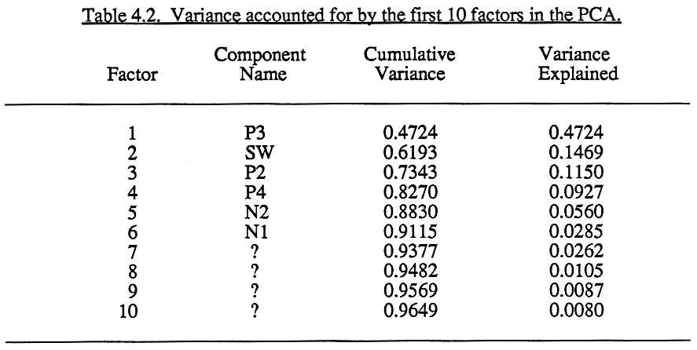
Temporal PCA Example
Luck (1986)
Notes:
© S. J. Luck. All Rights Reserved. May be used for nonprofit educational purposes if this copyright notice is included. Permission must be obtained from the copyright holder(s) for any other use.

Slide 24
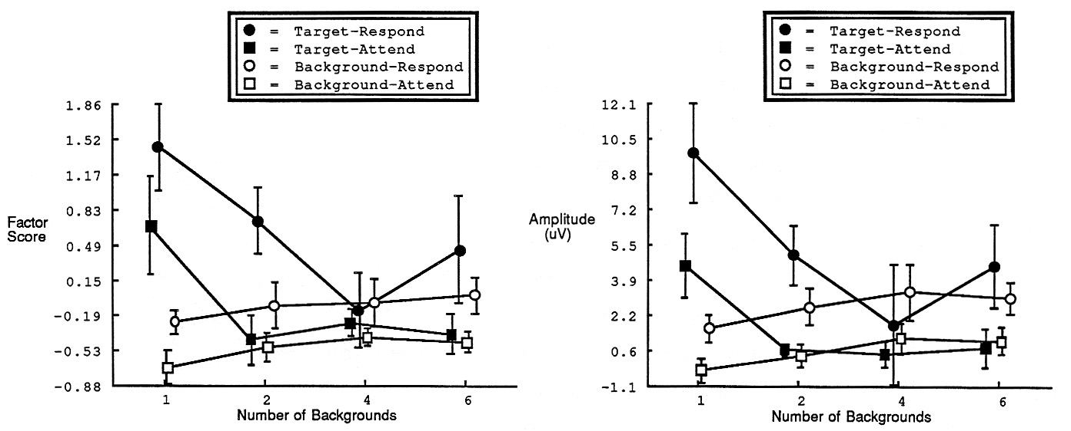
Temporal PCA Example
Factor Scores
(Factor 1)
P3 Amplitude
Luck (1986)
Notes:
© S. J. Luck. All Rights Reserved. May be used for nonprofit educational purposes if this copyright notice is included. Permission must be obtained from the copyright holder(s) for any other use.

Slide 25
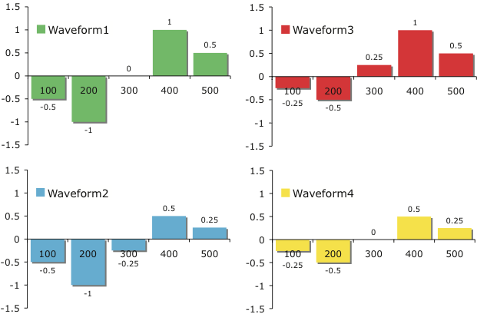
Example: ERP Waveforms
Variables: Amplitudes at N time points
Waveform varies across many different electrodes and experimental conditions
Notes:
© S. J. Luck. All Rights Reserved. May be used for nonprofit educational purposes if this copyright notice is included. Permission must be obtained from the copyright holder(s) for any other use.

Slide 26
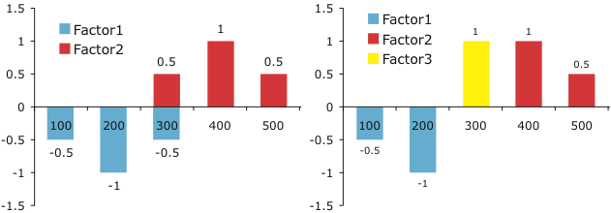
Example: Factor Loadings
Either of these sets of factors can fully explain the full waveforms
Each of the 4 waveforms can be reconstructed by summing the scaled factor loadings from either set of factors
Notes:
© S. J. Luck. All Rights Reserved. May be used for nonprofit educational purposes if this copyright notice is included. Permission must be obtained from the copyright holder(s) for any other use.

Slide 27
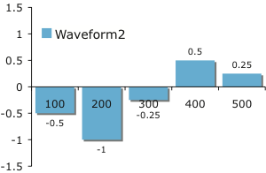
Example: Factor Scores
Factor Scores
Factor1: 1.0
Factor2: 0.5
Factor Scores
Factor1: 1.0
Factor2: 0.5
Factor3: -0.25
We have reduced 5 variables to 2 (left) or 3 (right) variables
Notes:
© S. J. Luck. All Rights Reserved. May be used for nonprofit educational purposes if this copyright notice is included. Permission must be obtained from the copyright holder(s) for any other use.

Slide 28
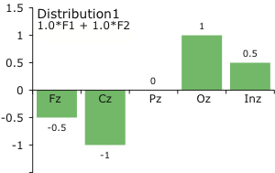
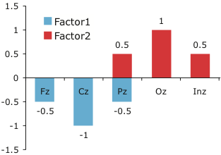
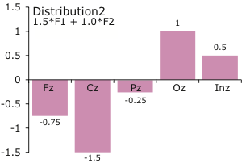
Spatial PCA
Variables: Amplitudes at N electrode sites
Scalp distribution varies across many different points in time and experimental conditions
Notes:
© S. J. Luck. All Rights Reserved. May be used for nonprofit educational purposes if this copyright notice is included. Permission must be obtained from the copyright holder(s) for any other use.

Slide 29
Shortcomings of PCA
The number of factors is always the same as the number of variables
  Some are just noise; which ones?
The factors are all orthogonal
  Real latent components are typically correlated
  Orthogonalization distorts factor loadings
  Orthogonalization misattributes variance to the wrong component
  But so do traditional measure such as peak and mean amplitude
  Non-orthogonal factors are possible, but it’s hard to know which set of non-orthogonal factors to choose
There are many ways to rotate the factors
  No way to know which is the correct or best rotation, even when you are limited to orthogonal factors
Notes:
© S. J. Luck. All Rights Reserved. May be used for nonprofit educational purposes if this copyright notice is included. Permission must be obtained from the copyright holder(s) for any other use.

Slide 30
Independent Component Analysis (ICA)
PCA uses linear correlations to determine factor structure; ICA uses all possible relationships
  A neural network “learns” the factor structure
The scalp distribution of an ICA component is usually consistent with a single dipole, even though the technique doesn’t “know” anything about the scalp locations, dipoles, volume conduction, etc.
Limitations of ICA
  N components are found; which are real?
    Not usually a problem when using ICA for artifact correction
  ICA components do not necessarily correspond with ERP components, as defined earlier
    ERP components may be correlated with each other, and the pattern of correlations will vary across experiments
Notes:
© S. J. Luck. All Rights Reserved. May be used for nonprofit educational purposes if this copyright notice is included. Permission must be obtained from the copyright holder(s) for any other use.

